Slide 1

Factor Analysis of Electric Vehicle Adoption

Slide 2
SDG
The Sustainable Development Goals (SDGs), also known as the Global Goals, were adopted by the United Nations in 2015 as a universal call to action to end poverty, protect the planet, and ensure that by 2030 all people enjoy peace and prosperity
Goal 13: CLIMATE ACTION.
“Greenhouse gas emissions are more than 50 percent higher than in 1990. Global warming is causing long-lasting changes to our climate system, which threatens irreversible consequences if we do not act.”

Slide 3
Impact of ICE Vehicles to Climate Change
Globally
vehicles release about 1.5 billion tons of greenhouse gases (GHGs) into the atmosphere each year—mostly in the form of carbon dioxide
USA
Greenhouse gas (GHG) emissions from transportation account for about 29 percent of total U.S. greenhouse gas emissions,
The largest contributor of U.S. GHG emissions

Slide 4
What Can we do?
Pollution control devices cannot reduce your car's CO2 emissions. You can only reduce them by
Choosing a car with better gas mileage
Getting the best fuel economy out of your car
Using a low-carbon fuel, such as ethanol or CNG
Purchasing green power for your electric vehicle or plug-in hybrid
Walking, biking, or taking public transit more often
Combining trips when possible (also saves time and money)

Slide 5
Aim
Analyze and understand the factors driving EV adoption in Washington State, and to provide recommendations for how to promote EV adoption in the state.
▪ Depends on the datasets we have, there are several objectives that can be analyzed, such as:
– Understand the trends and patterns of EV adoption in Washington State.
– Understand the characteristics of EV owners and how they differ from non-EV owners.
– Identify the factors that are driving EV adoption in Washington State, such as government policies, availability of charging infrastructure, and consumer preferences.
– Provide recommendations for how to promote EV adoption in Washington State based on the findings from the analysis – etc.

Slide 6
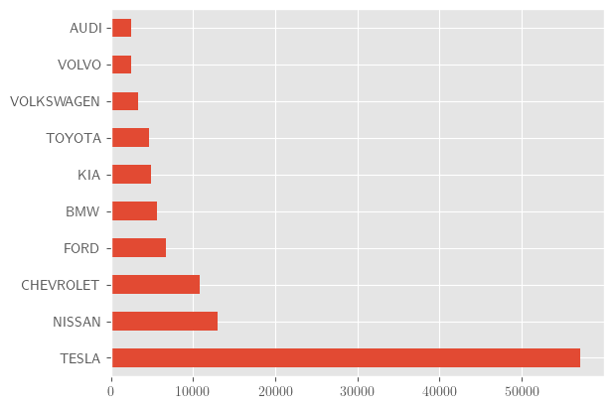
Top 10 Vehicle producers
Tesla dominates the market
First move advantage?
Dominant design?
Closest competitors
Nisan
Chevrolet

Slide 7
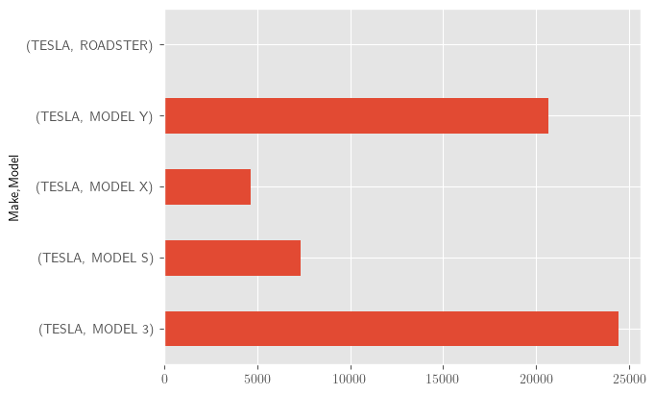
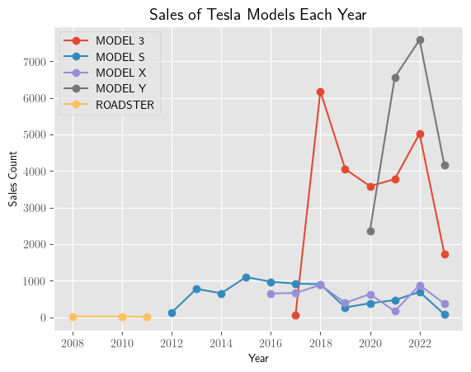
Tesla models sales
Model 3
Release year 2017
Starting price $40,240
`Model Y
Release year 2020
Starting price $50,490
Model S
Release year 2012
Starting price $88,490
Model X
Release year 2015
Starting price $98,490

Slide 8

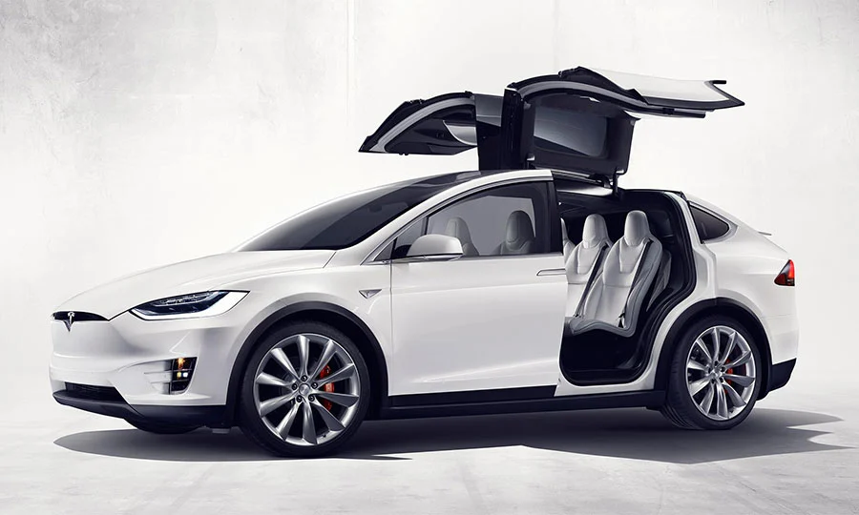
Tesla Features
Autopilot
Navigate on autopilot
AutoSteer
Smart summon
Full self-driving Capability
From home
To your Destination
Continuous software updates
Modern design
Different charging speeds
Car performance.
0-60 in 1.99-3.1s for model S
0-60 in 2.5-3.8s for model X
0-60 in 3.5-5s for model Y
0-60 in 3.1-5.8s for model 3

Slide 9
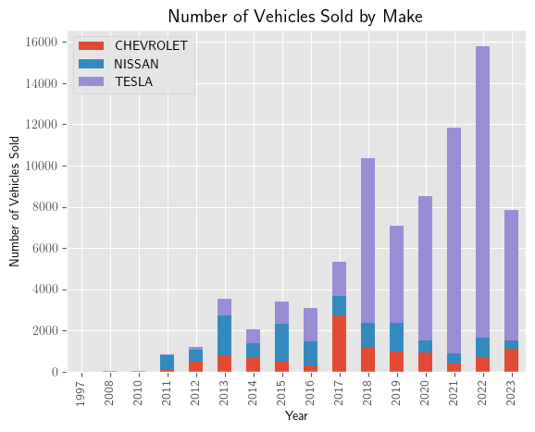
Top 3 Vehicle manufactures
Tesla
Huge spike in 2018 due to fixing manufacturing
Issues.
Introduction of first affordable model in 2017
Drop in 2019 sales due to Covid-19
Nissan
Had first move advantage
Outsold all competitors in 2013 and 2015
Sales had no significant increase
Nissan leaf planned to be discontinued in 2026
Chevrolet
Spike in 2017 due to introduction of their first EV
Bolt planned to discontinue by the end of 2023

Slide 10
Government policies
Government is aware of the climate change and is willing to promote EVs
Federal
July 11, 2011 Federal Tax Credits for the Purchase of Advanced Technology Vehicles. Updated and included in “Inflation Reduction Act of 2022”.
Eligible for a clean vehicle tax credit up to $7,500
State
Tax exemptions for alternative fuel vehicles and plug-in hybrids
The exemption applies to dealer and private sales of new, used, and leased vehicles sold on or after August 1, 2019.
New vehicle transactions must not exceed $45,000 in purchase price or lease payments
Used vehicles transactions must not exceed $30,000 in fair market value or lease payment

